Slide 1

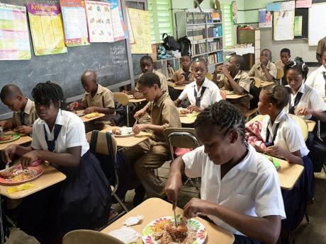
Healthy Eating and the 6 Food Groups
Love Your Body, Treat Your Body Right

Slide 2

Why do we eat food?

Slide 3

We eat food in order to get energy to carry out our daily activities, and to remain healthy

Slide 4

Importance of Healthy Eating
Healthy eating is important for good health and development
The “Food Based Dietary Guidelines” help us to understand how to eat healthily

Slide 5

National Food Based Dietary Guidelines
Gives a guide to healthy eating
Foods arranged in groups
6 food groups

Slide 6
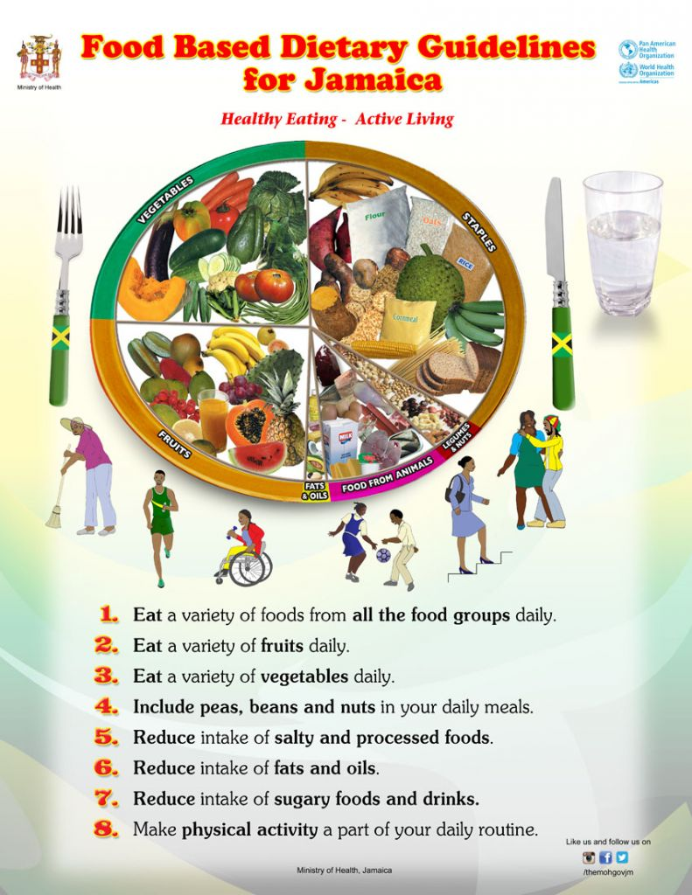

Slide 7

Foods are placed into groups based on the major nutrients they provide

Slide 8
MAKING HEALTHY CHOICES

Slide 9




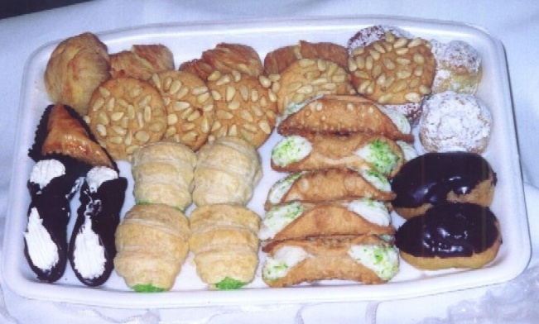
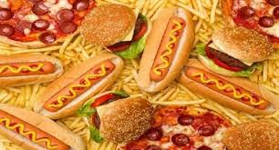
Reduce your intake of sugary foods/drinks, fatty and salty foods
Notes:
Relate also to dental caries

Slide 10
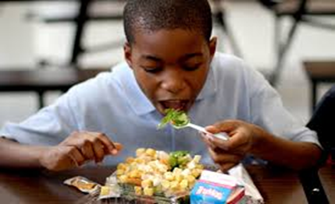


CUT BACK ON SUGARY DRINKS
Drinking or eating large amounts of sugar can lead to serious health problems as you get older
such as increasing your risk of:
  tooth decay
  gaining too much weight and developing diabetes

Slide 11
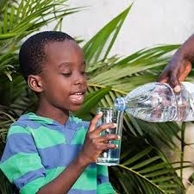
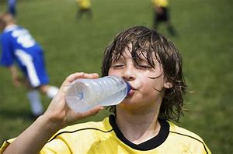





DRINK WATER INSTEAD
Choose water instead of sugary drinks.
  It keeps your blood flowing, and helps your body get rid of waste.

Slide 12
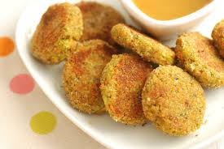



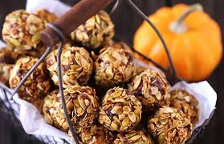
Good Snack Ideas
EAT MORE FRUITS & VEGETABLES
CUT BACK ON SUGARY DRINKS

Slide 13



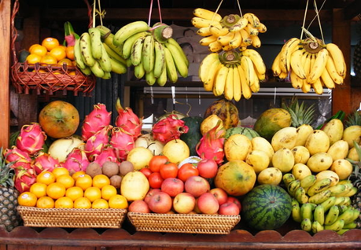
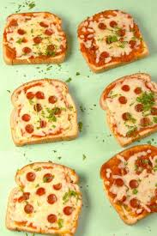


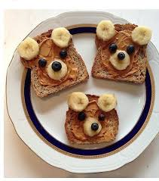
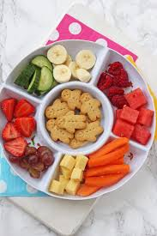
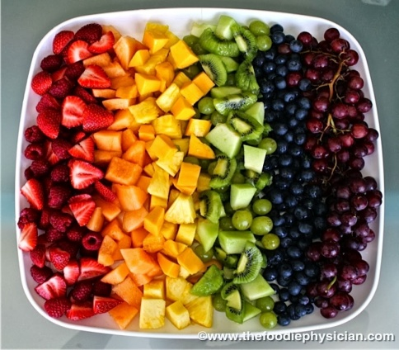

Good Snack Ideas

Slide 14


STARTING EARLY CAN END GREAT

Slide 15





THAT’S IT
!!

